Slide 1
Introduction to K-Nearest Neighbors (KNN)
A Supervised Learning Algorithm for Classification and Regression
Hasan MISAII

Slide 2

Agenda
Introduction to KNN
How KNN works
Distance Metrics in KNN
Choosing the Value of K
Advantages and Disadvantages
Example with Python and R Codes
Summary

Slide 3
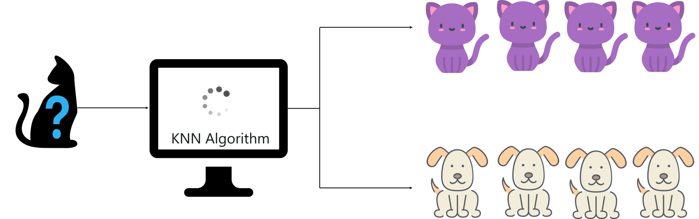
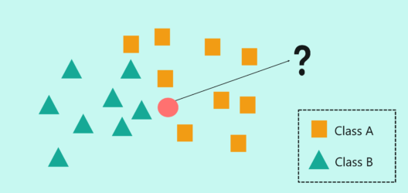
Introduction to KNN

Slide 4
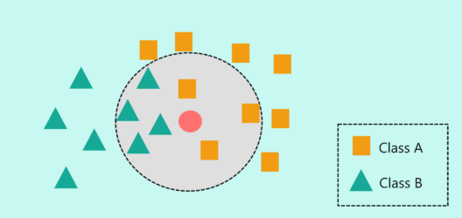
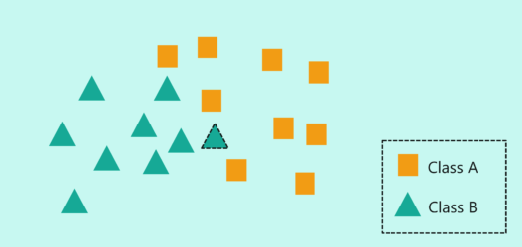
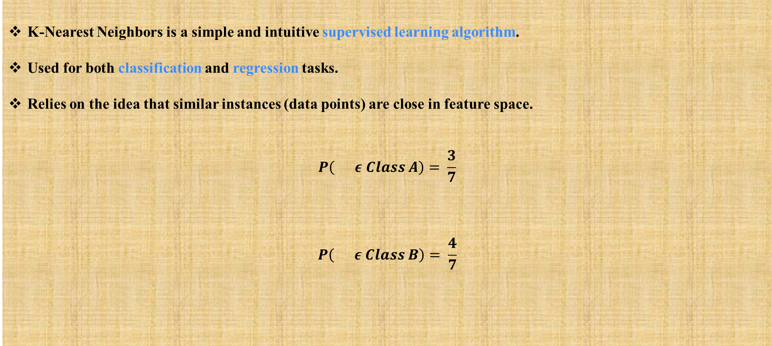
What is KNN?
K-Nearest Neighbors is a simple and intuitive supervised learning algorithm.
Used for both classification and regression tasks.
Relies on the idea that similar instances (data points) are close in feature space.
$$P\left( ε Class A\right)= \frac{3}{7}$$
$$P\left( ε Class B\right)= \frac{4}{7}$$
K=7

Slide 5
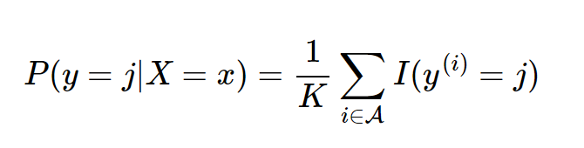
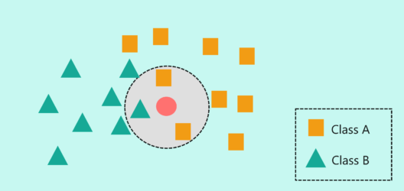
How KNN Works?
Choose a value for K (number of neighbors);
Calculate the distance between the new point and all points in the dataset;
Select the K closest neighbors;
For Classification: Assign the majority label among the neighbors;
For Regression: Calculate the average of the neighbors' values.
K=3

Slide 6
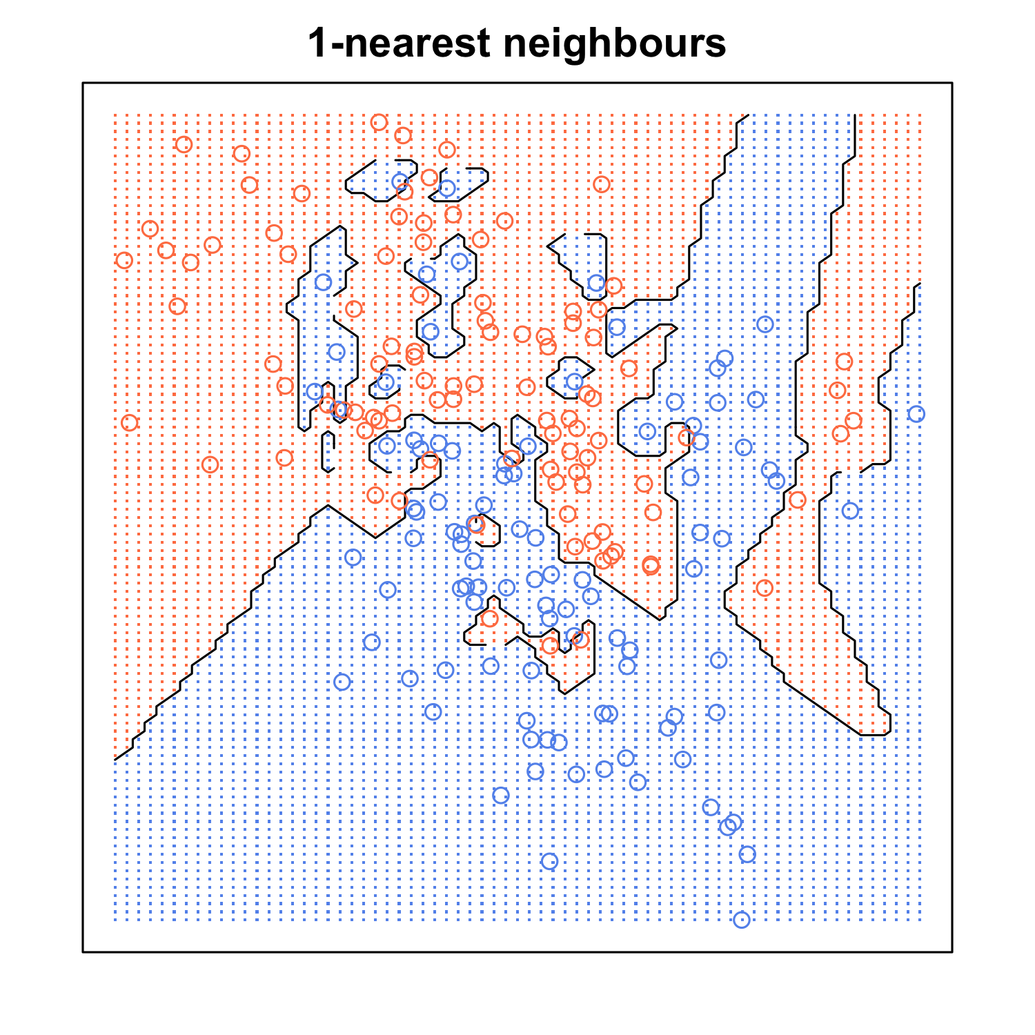
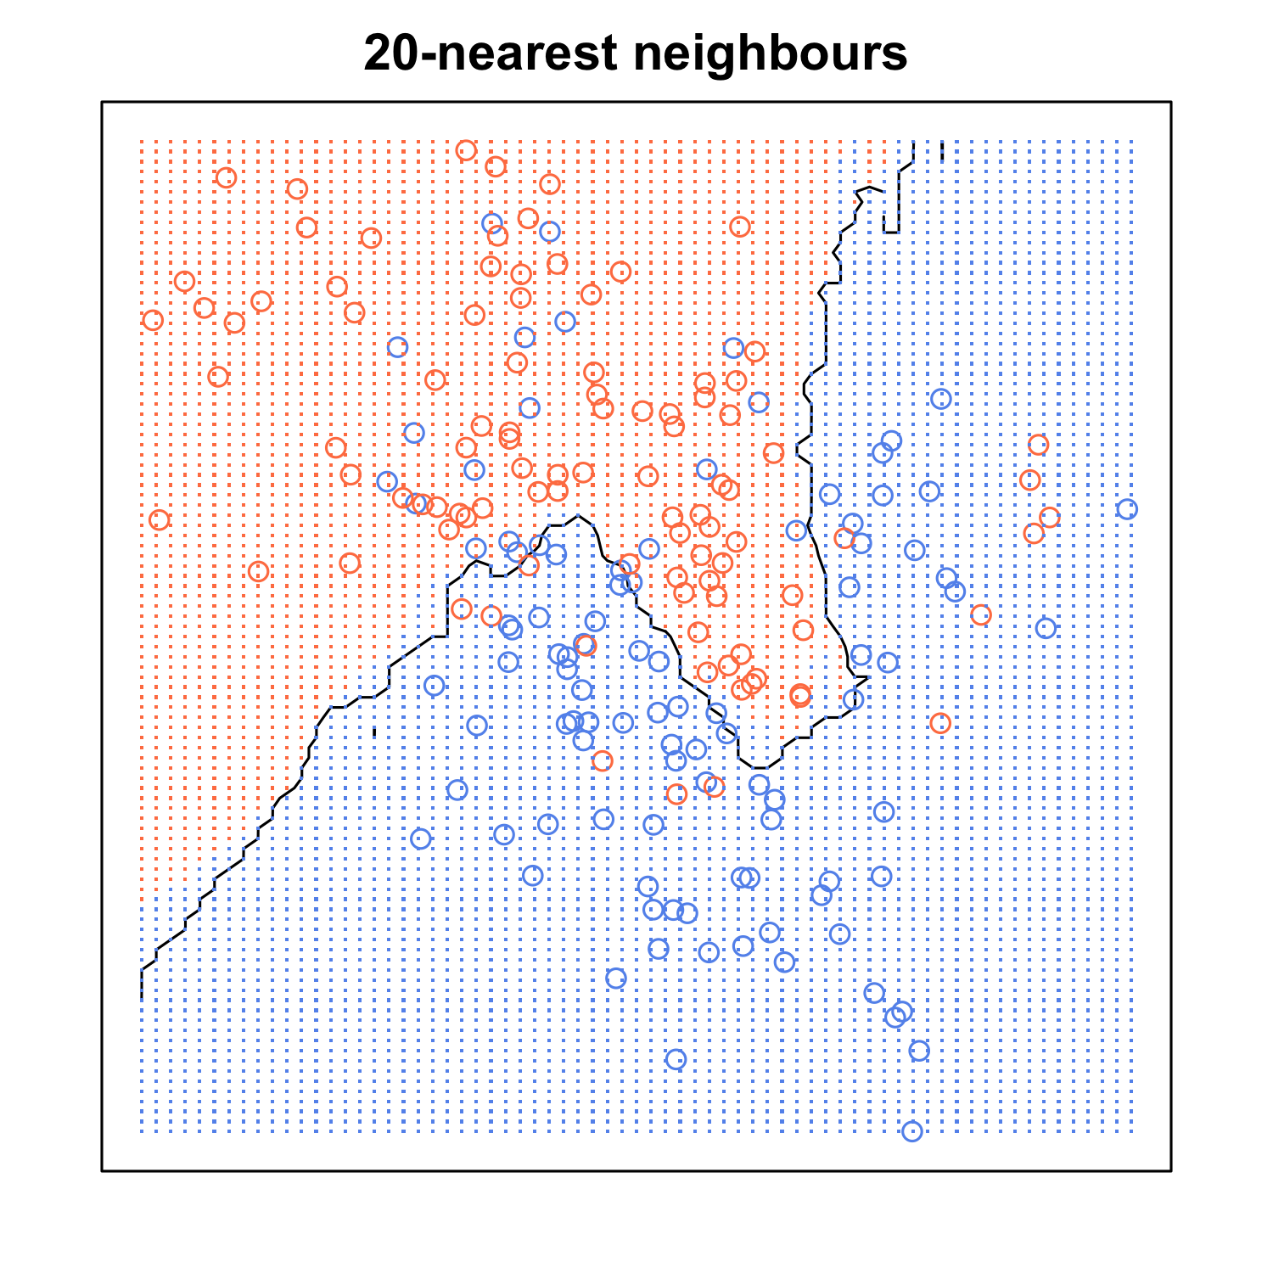
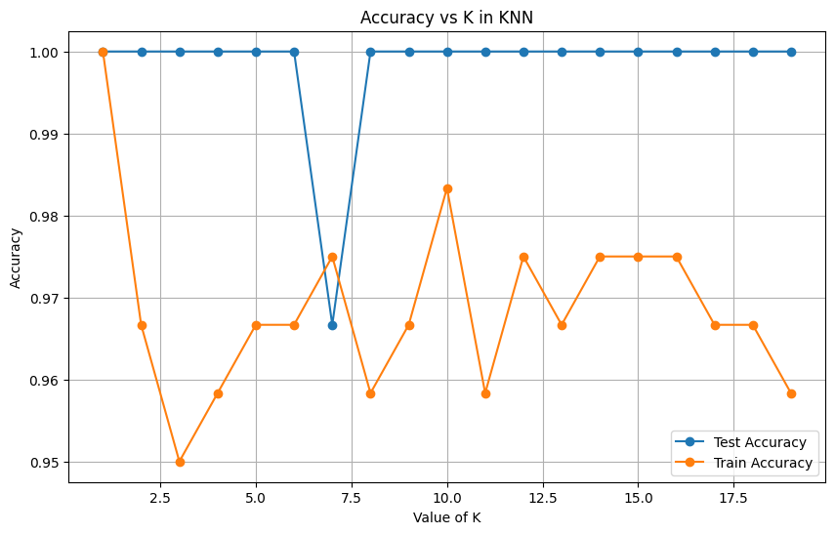
How to Choose K?
Small K (e.g., K=1): Can lead to overfitting and sensitivity to noise (provides the most flexible fit, which will have low bias but high variance).
Large K: can lead to underfitting, as the model becomes too generalized (have smoother decision boundaries which means lower variance but increased bias).
Cross validation is often used to find the optimal value of K.
Github_Link
Understanding the Bias-Variance Tradeoff

Slide 7
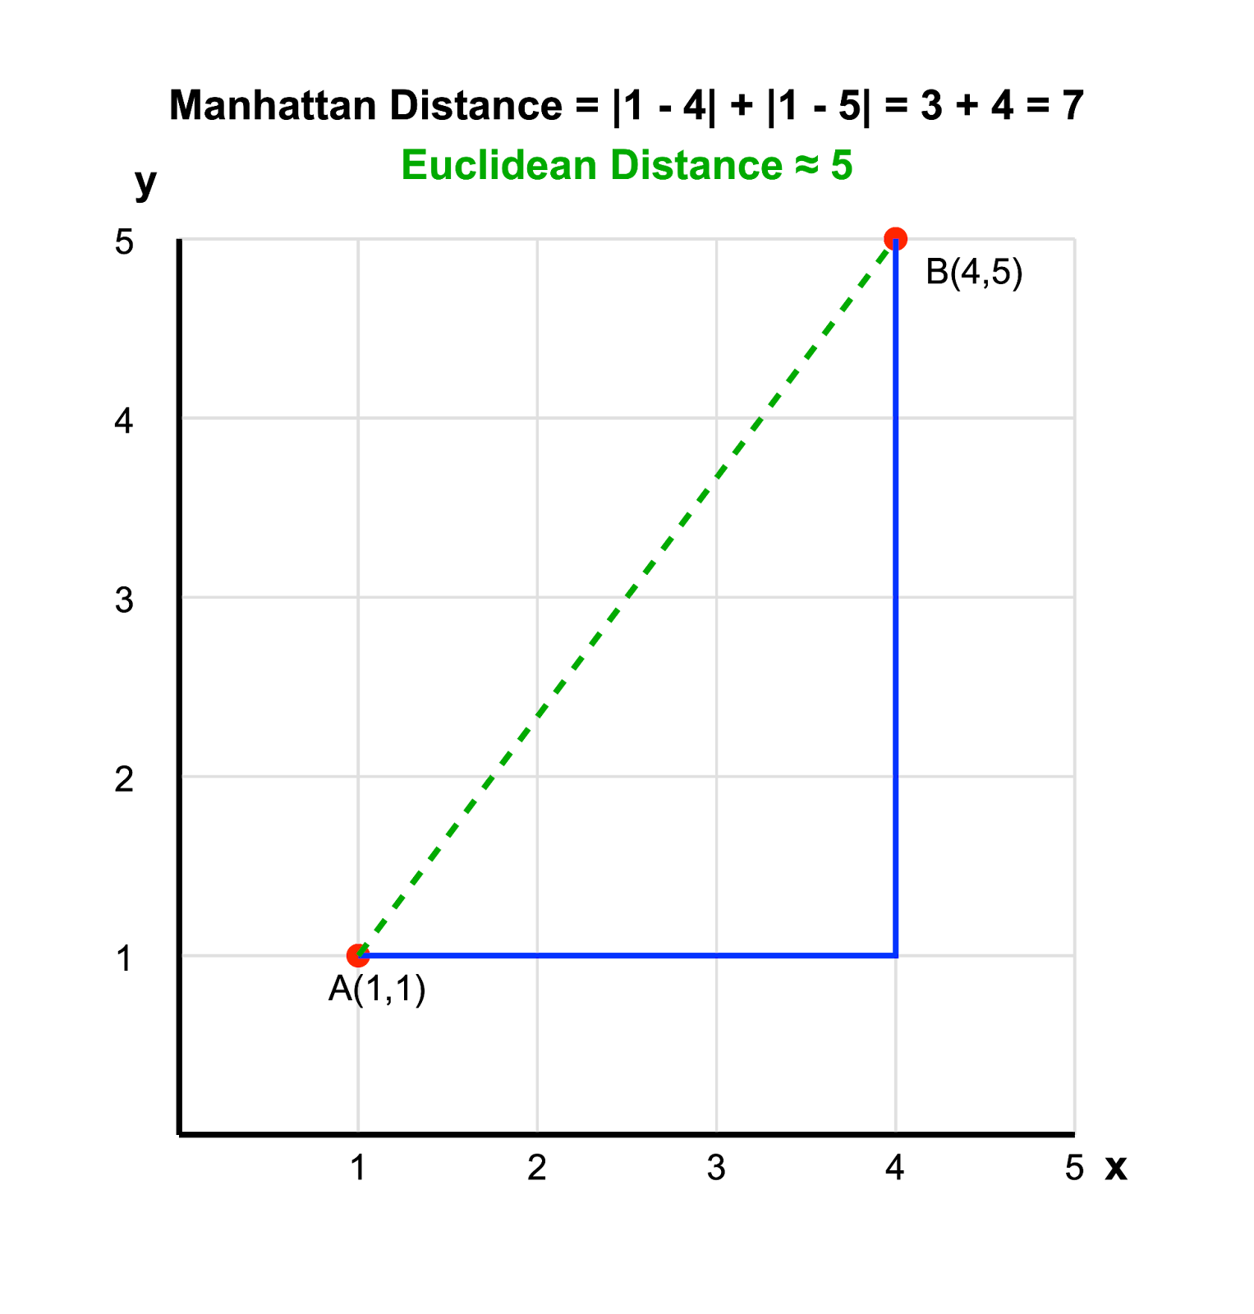
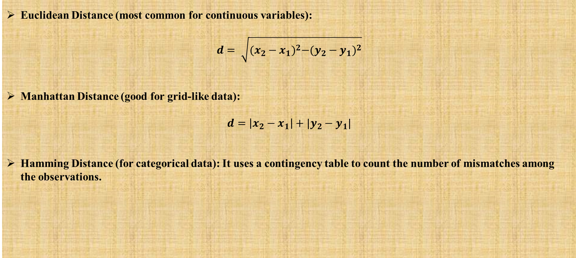
Distance Metrics in KNN
Euclidean Distance (most common for continuous variables):
$$d= \sqrt{{(x_{2}−x_{1})}^{2}−{(y_{2}−y_{1})}^{2}}$$
Manhattan Distance (good for grid-like data):
$$d=\left|x_{2}−x_{1}\right|+|y_{2}−y_{1}|$$
Hamming Distance (for categorical data): It uses a contingency table to count the number of mismatches among the observations.

Slide 8
KNN implementation (Python)
from sklearn.neighbors import KNeighborsClassifier
from sklearn.datasets import load_iris
from sklearn.model_selection import train_test_split
from sklearn.metrics import accuracy_score
# Load the dataset
iris = load_iris()
X, y = iris.data, iris.target
# Split the data
X_train, X_test, y_train, y_test = train_test_split(X, y, test_size=0.3, random_state=42)
# KNN Classifier
knn = KNeighborsClassifier(n_neighbors=3)
knn.fit(X_train, y_train)
# Make predictions and calculate accuracy
y_pred = knn.predict(X_test)
accuracy = accuracy_score(y_test, y_pred)
print(f"Accuracy: {accuracy * 100:.2f}%")
Github_Link

Slide 9
KNN implementation (R)
Let’s see it as a practice!
Choose a dataset in R and try to make a KNN classification or regression Task;)
HINT

Slide 10
Advantages and Disadvantages of KNN
Simple and easy to implement
Works well for small datasets
No train phase; predictions made in real time
Computationally expensive for large datasets (distance to all points needs to be computed)
Requires feature scaling
Sensitive to irrelevant features
advantages
disadvantages

Slide 11
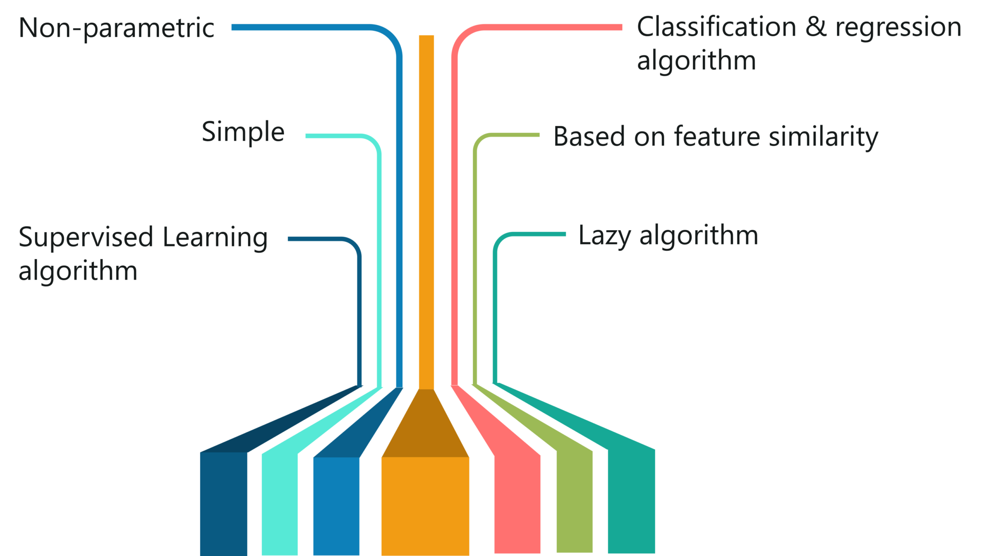
Summary
KNN

Slide 12
Thank you
hasanmisaii14@gmail.com

